Slide 1


Email Signature

Slide 2

Authorized Signature Format
AFEX
Regards
Ciroma Chukwuma Adekunle | Analyst, Clearing and Settlement
P: +234890123456
E: ayoungman@afexnigeria.com
W: africaexchange.com
Font Style: Century Gothic
Size: 10pt

Slide 3

For Outlook Website

Slide 4

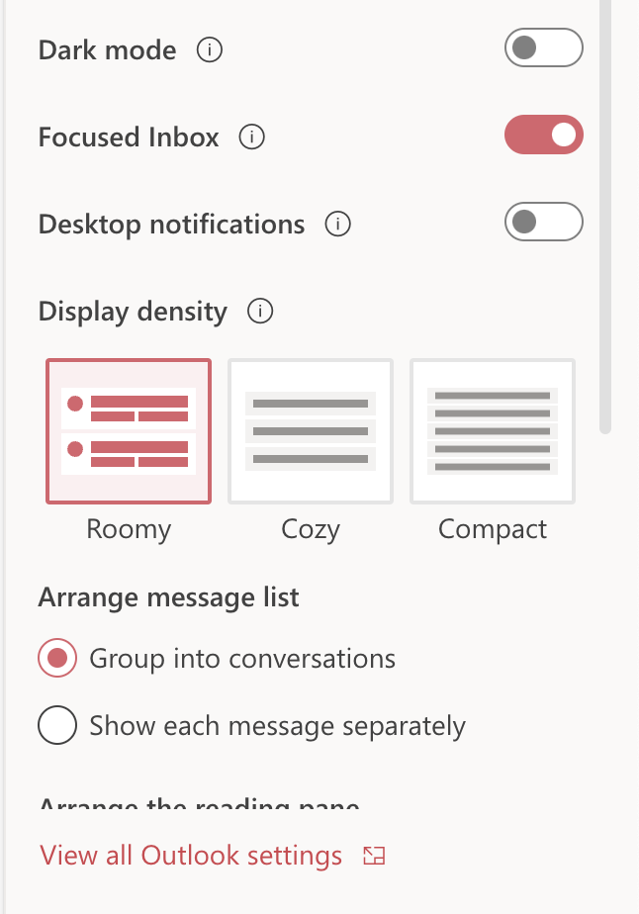
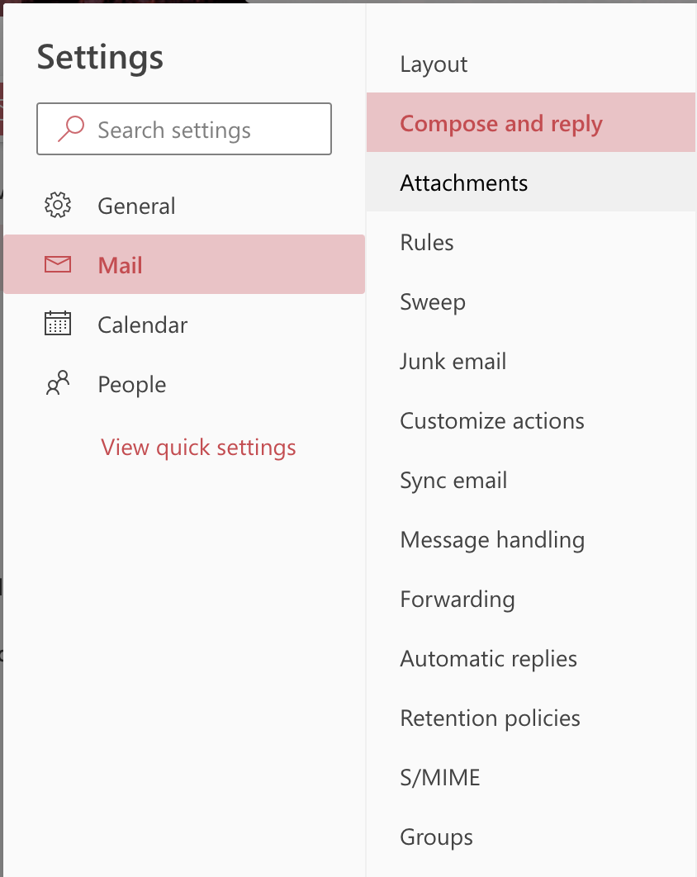
AFEX
Sign in to the Outlook on the web
Go to
Setting
Click View all Outlook settings
Select
Mail
Click
Compose and reply

Slide 5
Under Email signature, copy and paste the Email Signature template in the box (Replace the names phone numbers, emails and job titles with yours)
Click on ‘New Signature’ and give it a name
Select, Save when you are done.
Copy This
Regards
Ciroma Chukwuma Adekunle | Analyst, Clearing and Settlement
P: +234890123456
E: ayoungman@afexnigeria.com
W: africaexchange.com

Slide 6
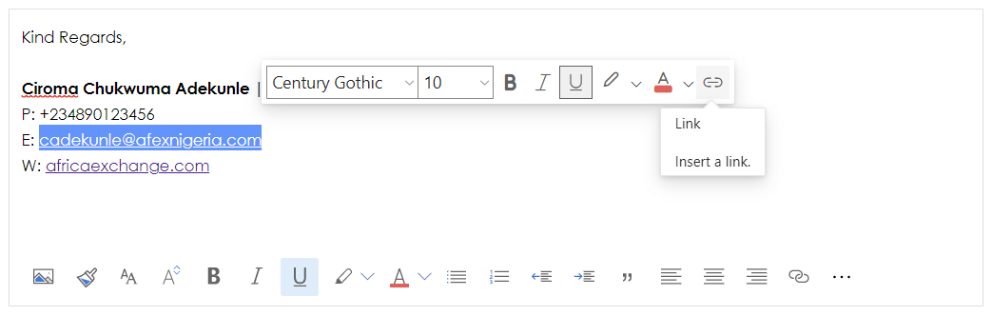
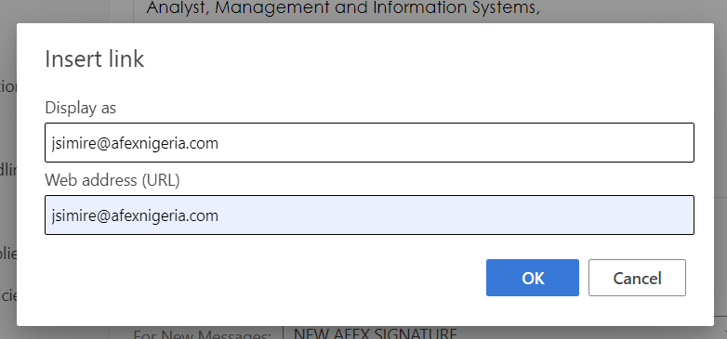
AFEX
Repeat the process for website and use the company website (africaexchange.com)
Under Web Address (URL), input your AFEX mail
Highlight the email address
Click the link icon
Click
Compose and reply

Slide 7

For Outlook App Desktop

Slide 8
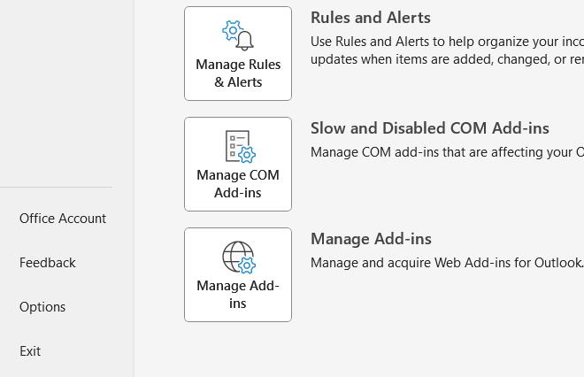
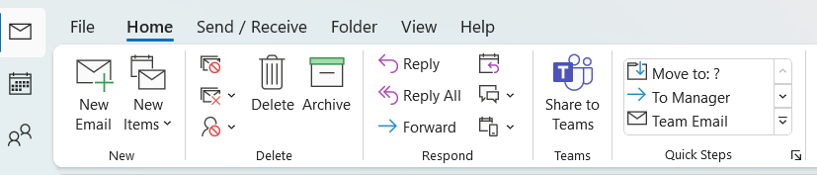
Click on ‘options’ between Feedback and exit
Sign in on your Outlook desktop app
Click on file (beside home)
a

Slide 9
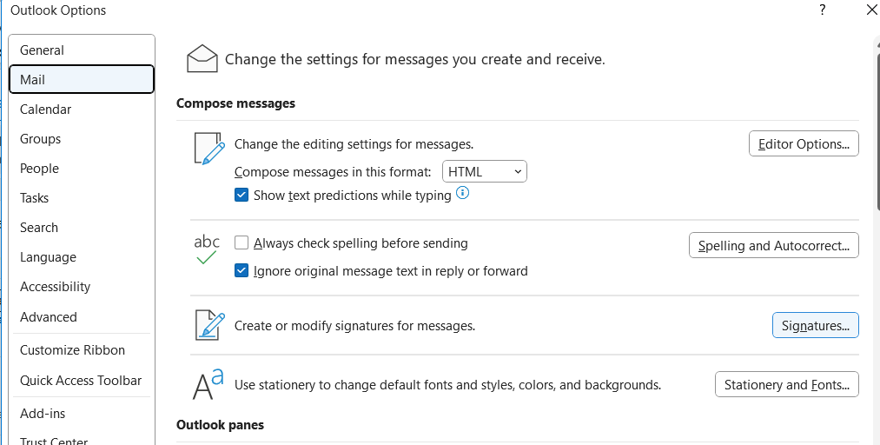
AFEX
Click on mail
Click on the signature

Slide 10
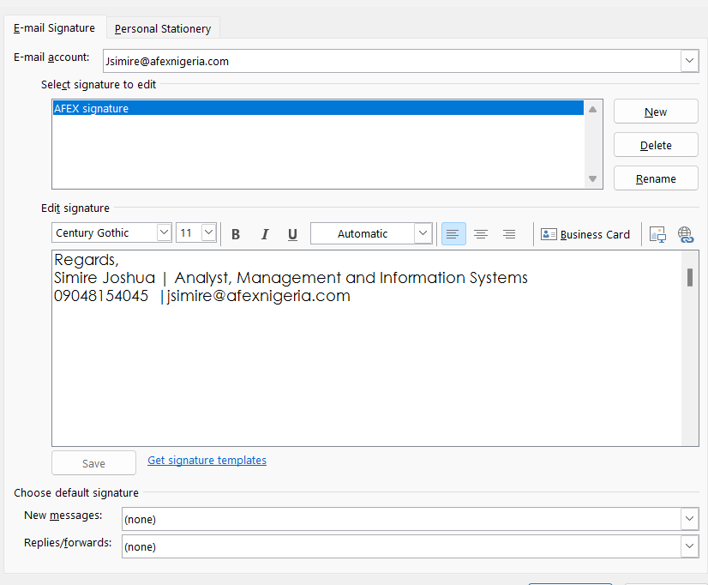
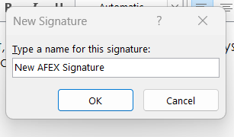
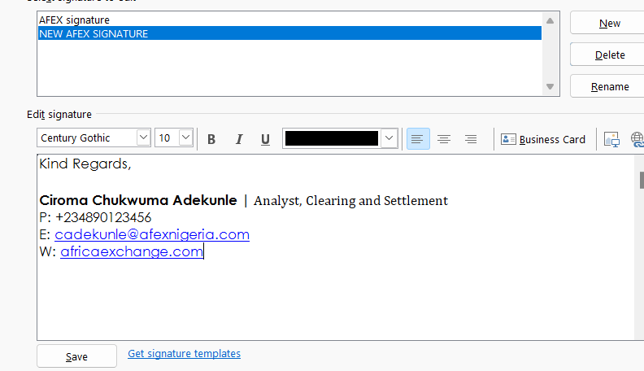
AFEX
In the Pop window, give the new signature a name and select "OK"
Copy and paste
the Email signature in the "Edit Signature " field and click on save (Replace the names, phone numbers, emails and job titles with yours)
Click on New

Slide 11
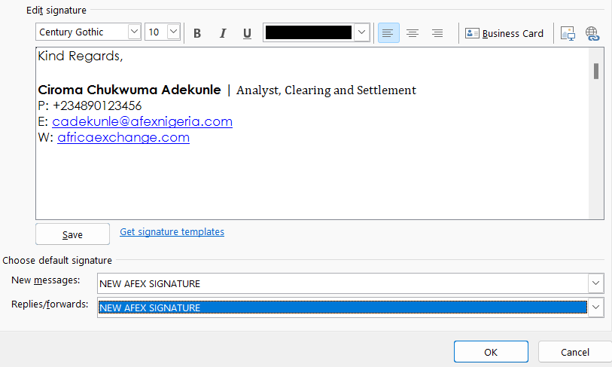
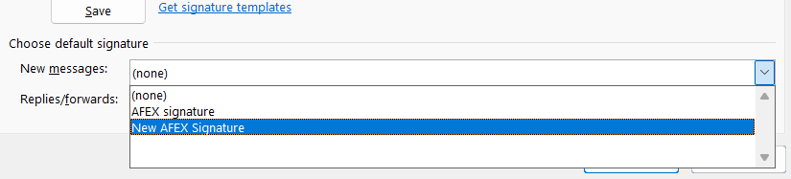
AFEX
Click on the
dropdown menu in
the "New Messages:" field and select the New signature to which you just created and assigned a
name (slide #9)
Repeat the process for Replies/Forwards: and click on "OK" when done
Click on "OK"
Close all other pop windows
a

Slide 12
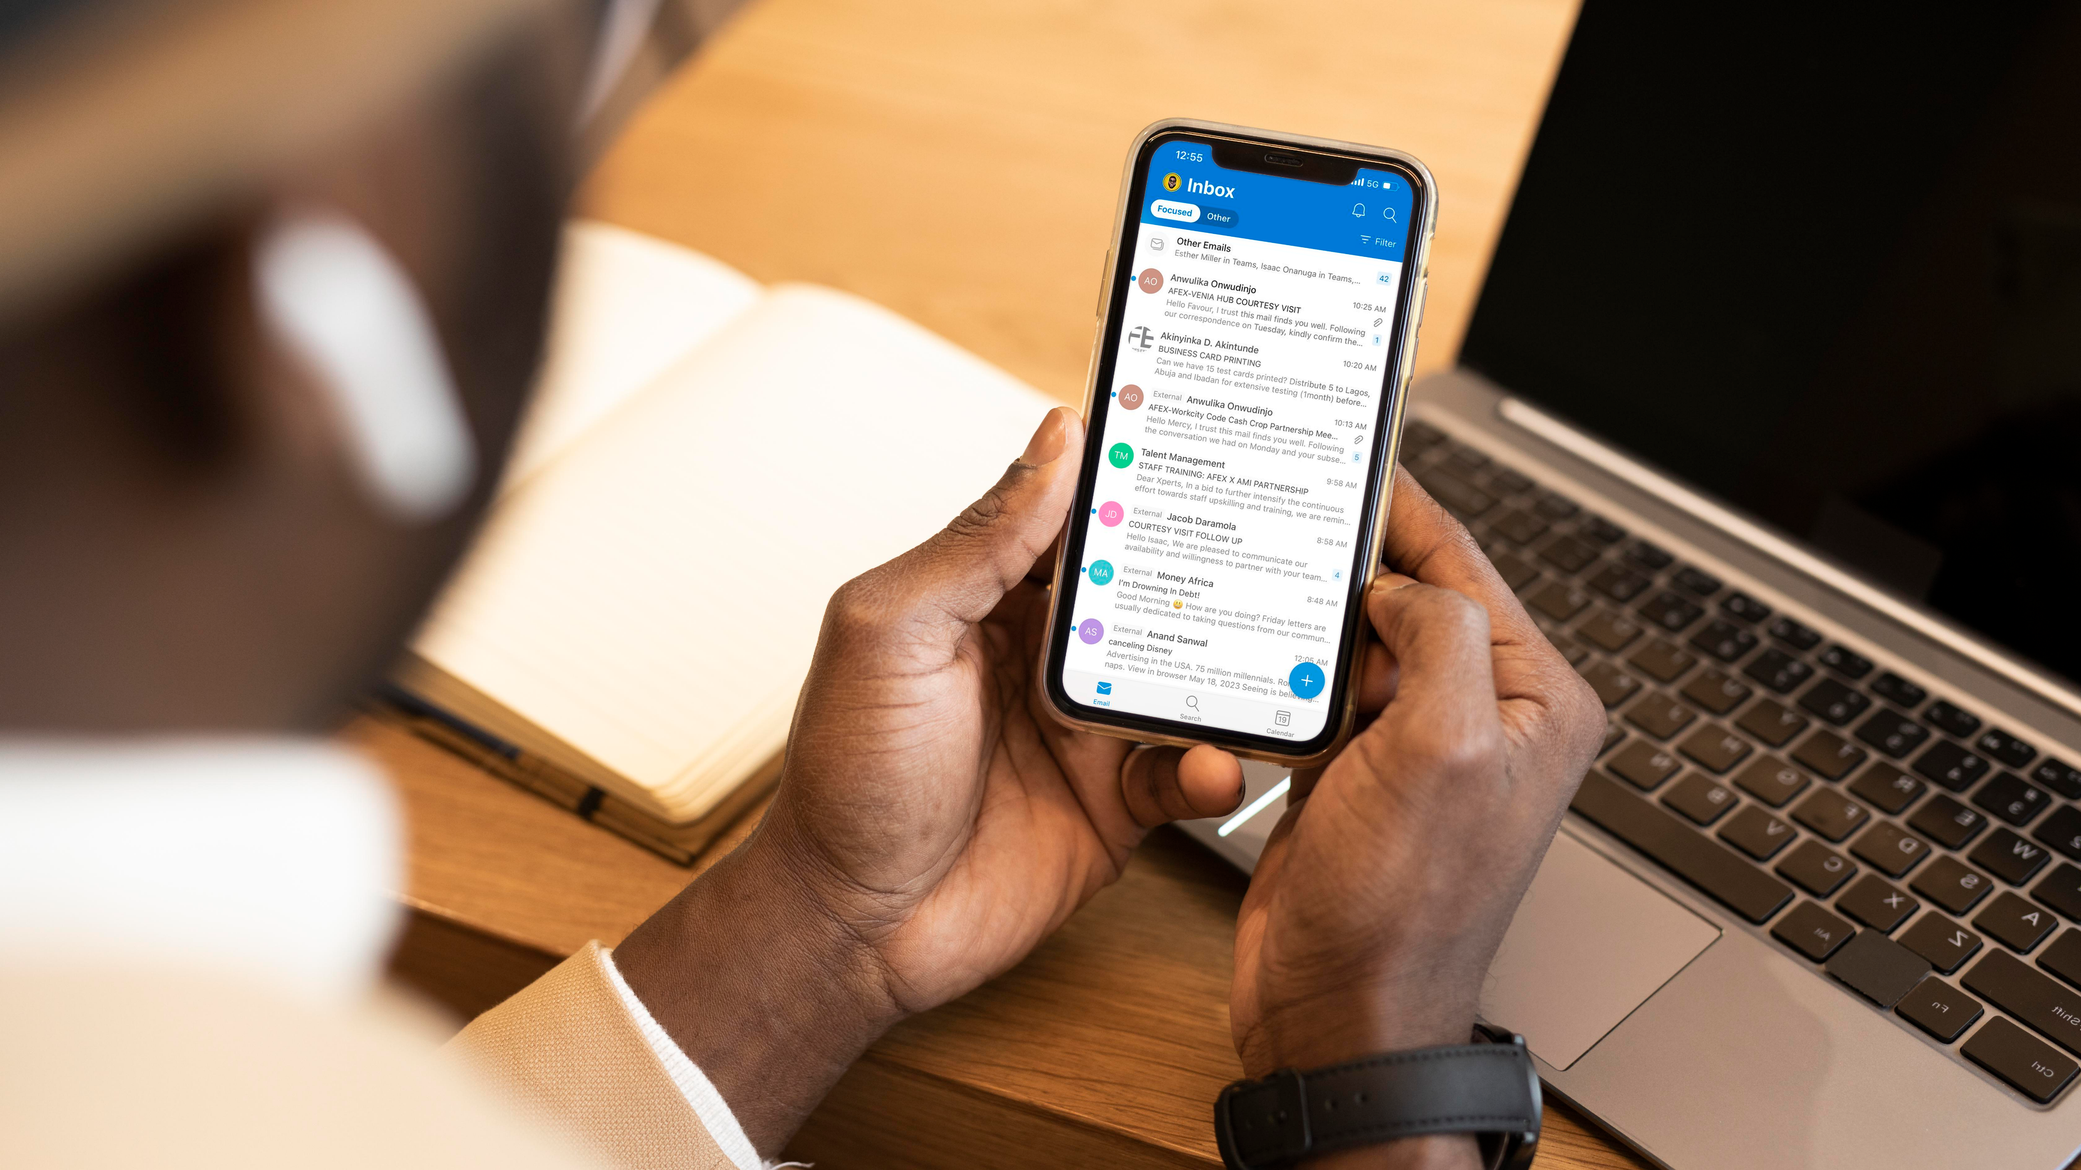
For Outlook Mobile App

Slide 13
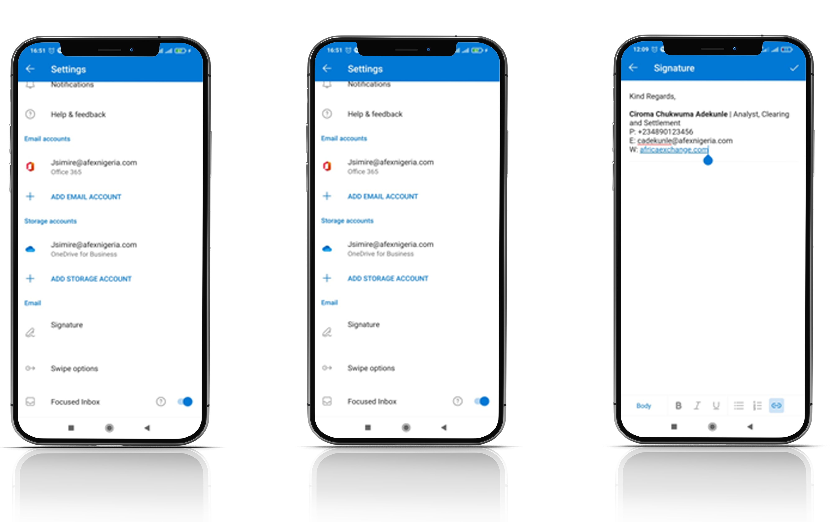
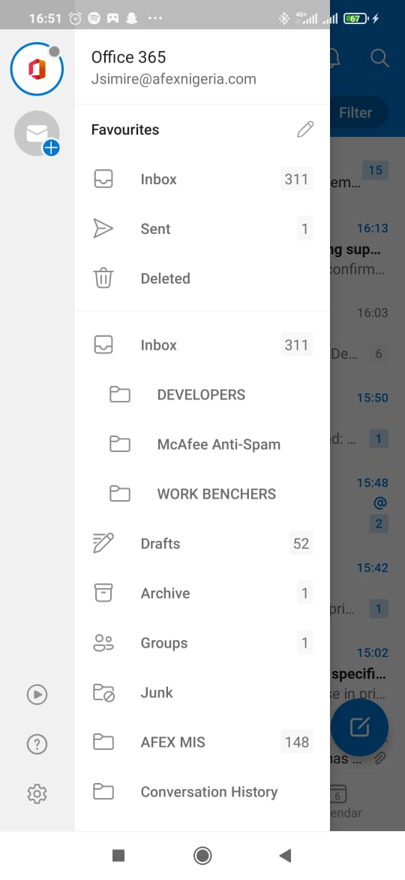
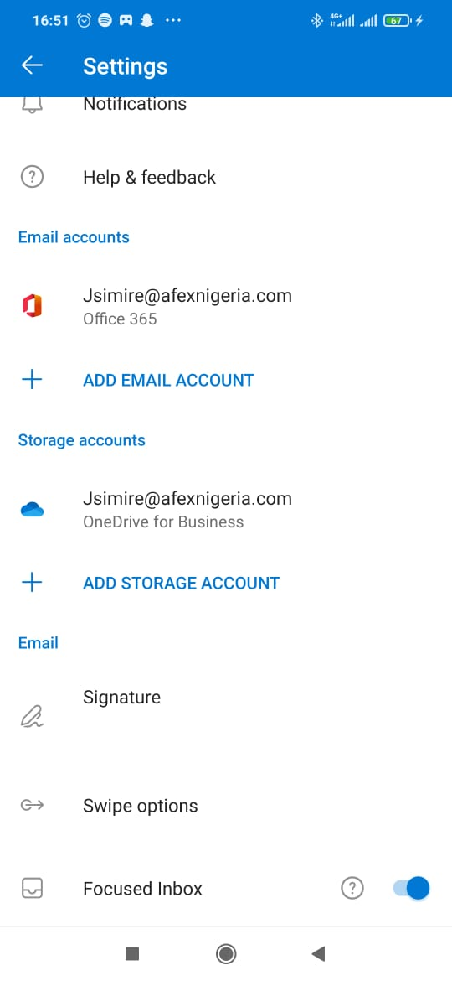
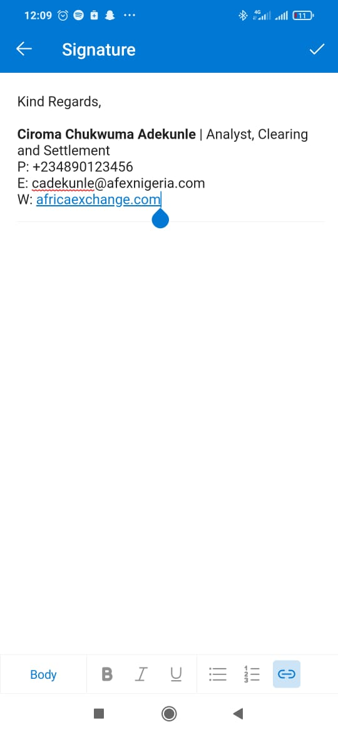
AFEX
Copy and
paste the Email signature in the "Edit Signature" field and click on save (Replace the names, phone numbers, emails and job titles with yours)
Sign in on the Outlook app on your phone
Navigate to the app's settings (it is usually a gear looking icon)
Click on
"save' or "ok" when done
Select the signature option

Slide 14
Thank You

